Slide 1
10 Enrichment Science
Other patterns of inheritance:
SEX LINKED

Slide 2
Review
So far, we’ve learned about dominant/recessive, incomplete dominant and co-dominant patterns of inheritance.

Slide 3
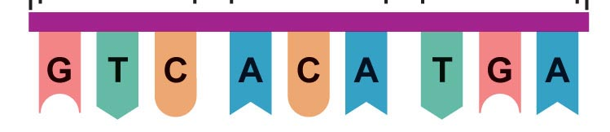
Review
Draw a labelled diagram showing the components of DNA (one nucleotide)
Draw the complimentary strand for

Slide 4
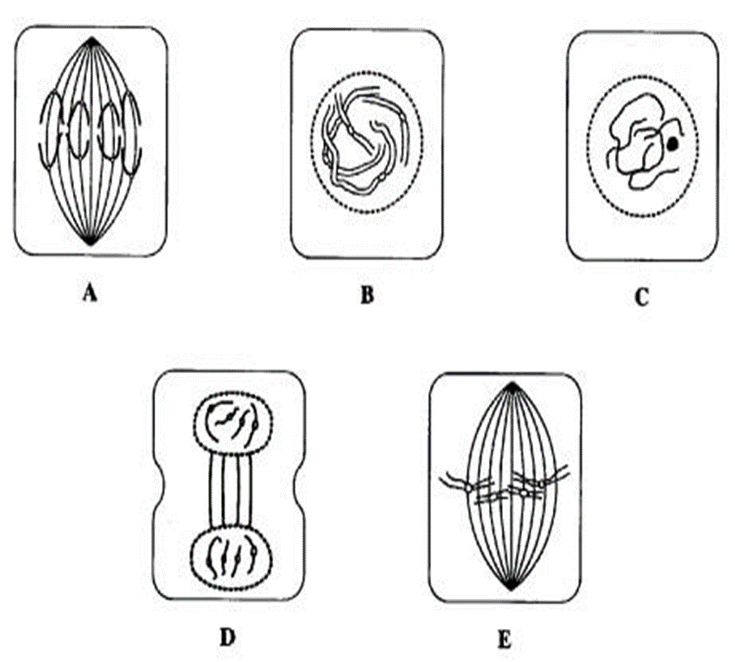
Review
3. Label these phases of mitosis

Slide 5
Review
4. List the differences between mitosis and meiosis in terms of
number of chromosomes
number of cells produced
where it happens
why it happens

Slide 6
Review
5. Explain the difference between dominant, recessive, incomplete dominant and co-dominant patterns of inheritance.

Slide 7
Learning intention
Understand that genes for some characteristics are carried on the sex (X and Y) chromosomes and that whether the person is male or female will affect their genotype and phenotype.
Give examples of sex linked conditions
Use simple pedigree diagrams

Slide 8
Success criteria
Explain why some conditions are more common in males than females due to X-linked patterns of inheritance
Give two examples of conditions that show X-linked inheritance patterns
Use punnet squares to predict genotype and phenotype for X-linked conditions
Use pedigrees to show dominant, recessive and X-linked conditions

Slide 9
Key words
sex linked (sometimes called X linked)
carrier
pedigree

Slide 10
Sex chromosomes and sex linked conditions
In humans there are 44 non-sex chromosomes (22 pairs) and 2 sex chromosomes (XX or XY).

Slide 11
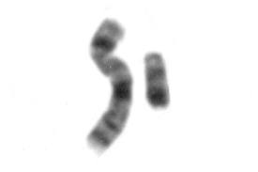
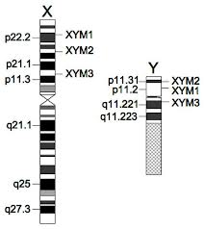
The X chromosome is much longer than the Y chromosome. Some genes on the X chromosome have no corresponding gene on the Y chromosome.

Slide 12
Red green colour-blindness
The gene for red-green colour-blindness is carried on the X chromosome and is recessive. This means that a female would need to have two affected genes to have the condition, but a male needs to only have one affected gene.

Slide 13
Ishihara Test | Color Test | Ishihara Chart (colorblindnesstest.org)

Slide 14
Alleles and genotypes
X : a normal X
X^{r} : a red-green colourblind X
Y: a Y chromosome
XX: normal female X^{r}X: carrier female
X^{r}X^{r}: affected female
XY: normal male X^{r}Y: affected male

Slide 15
Sex linked conditions are much more common in males than females.

Slide 16
Example:
A woman whose father was red-green colourblind had children with an unaffected man. Determine the possible genotypes and phenotypes of the children.
Mother X^{r}X Father XY

Slide 17
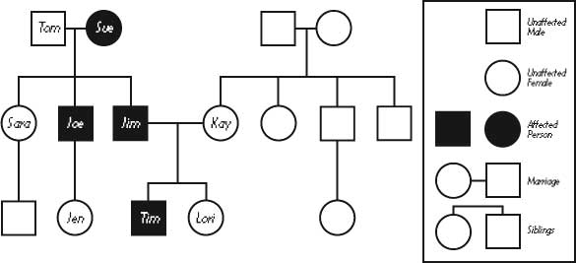
Pedigrees

Slide 18
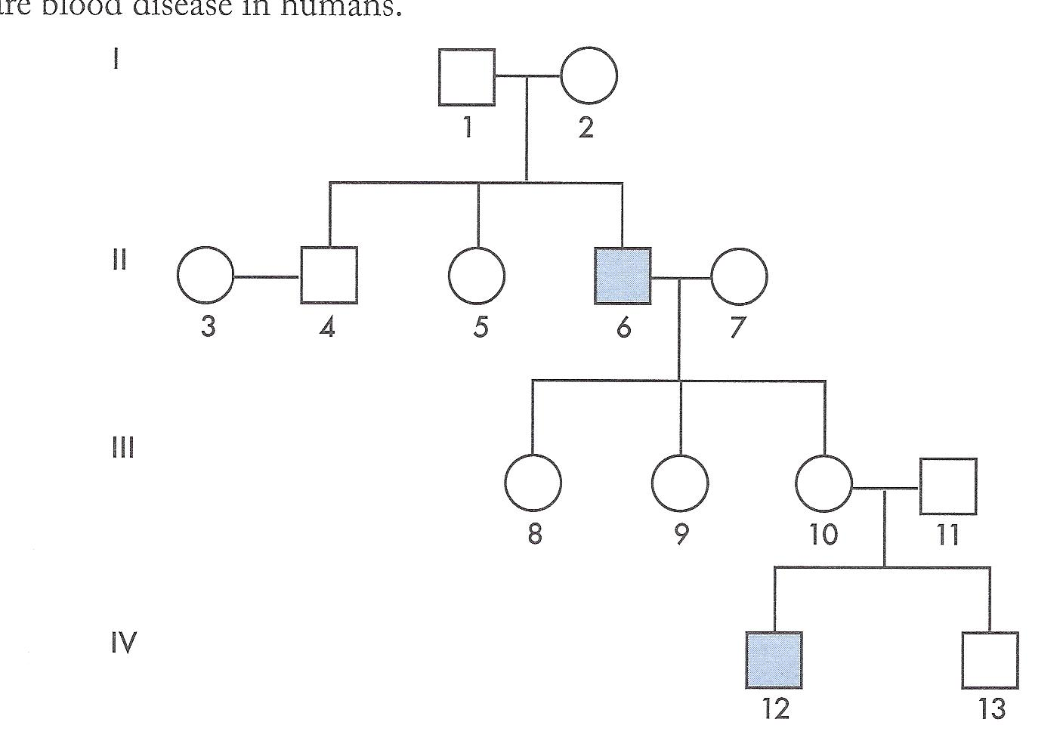

Slide 19
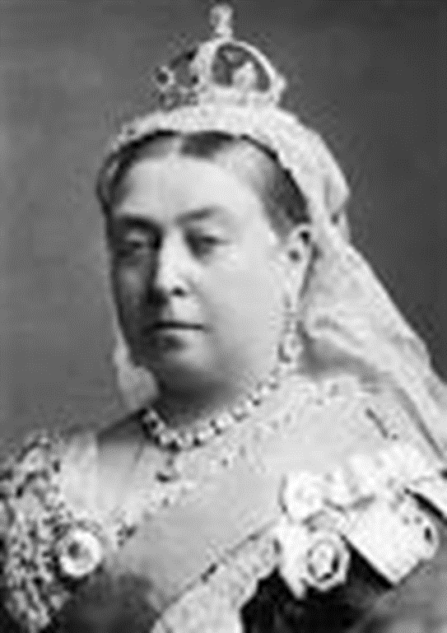
Haemophilia: The Royal Disease

Slide 20
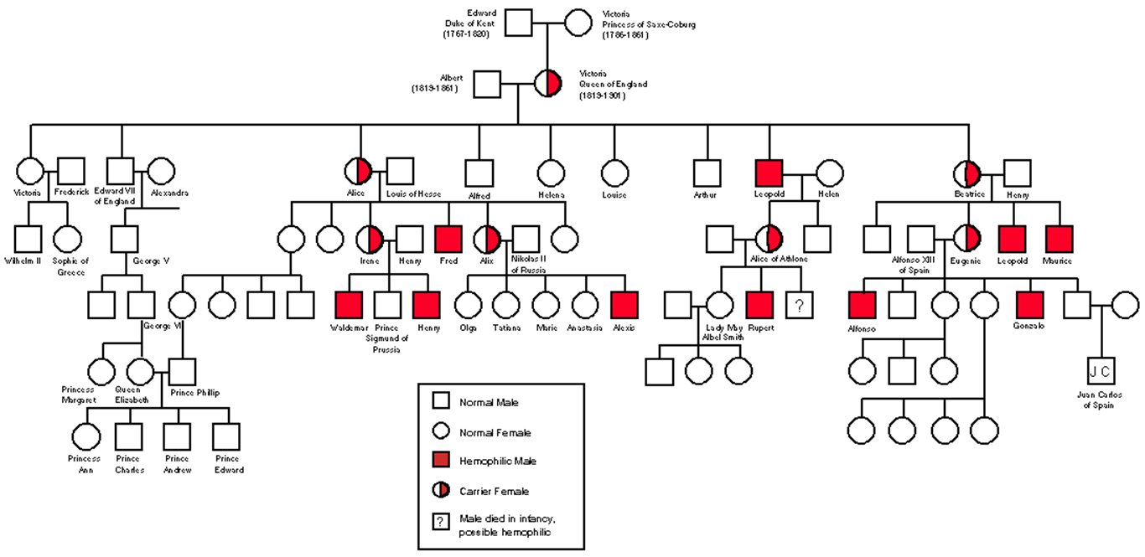

Slide 21
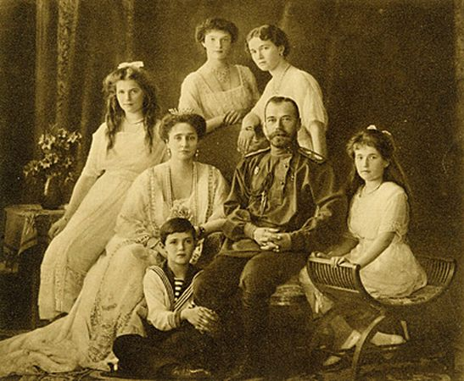

Slide 22
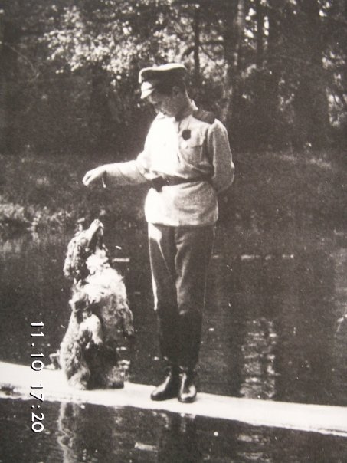

Slide 23


Slide 24


Slide 25
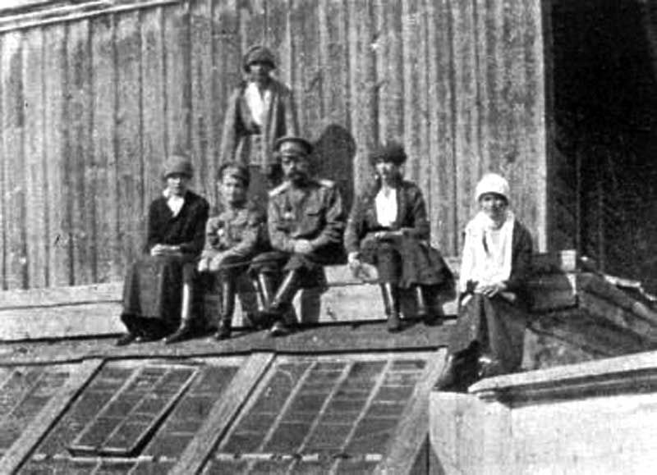

Slide 26


Slide 27
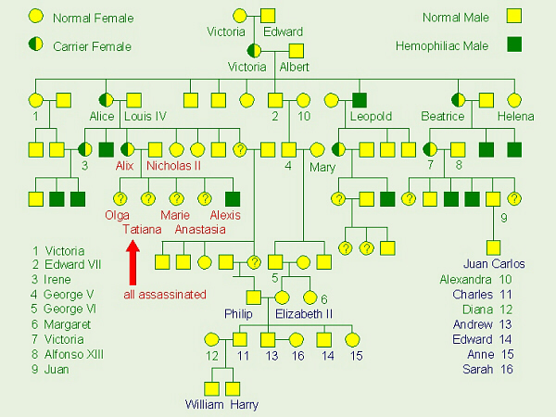
The Most Famous Pedigree

Slide 28
Success criteria
Explain why some conditions are more common in males than females due to X-linked patterns of inheritance
Give two examples of conditions that show X-linked inheritance patterns
Use punnet squares to predict genotype and phenotype for X-linked conditions
Use pedigrees to show dominant, recessive and X-linked conditions

